Slide 1
Endocrine System In Detail

Slide 2
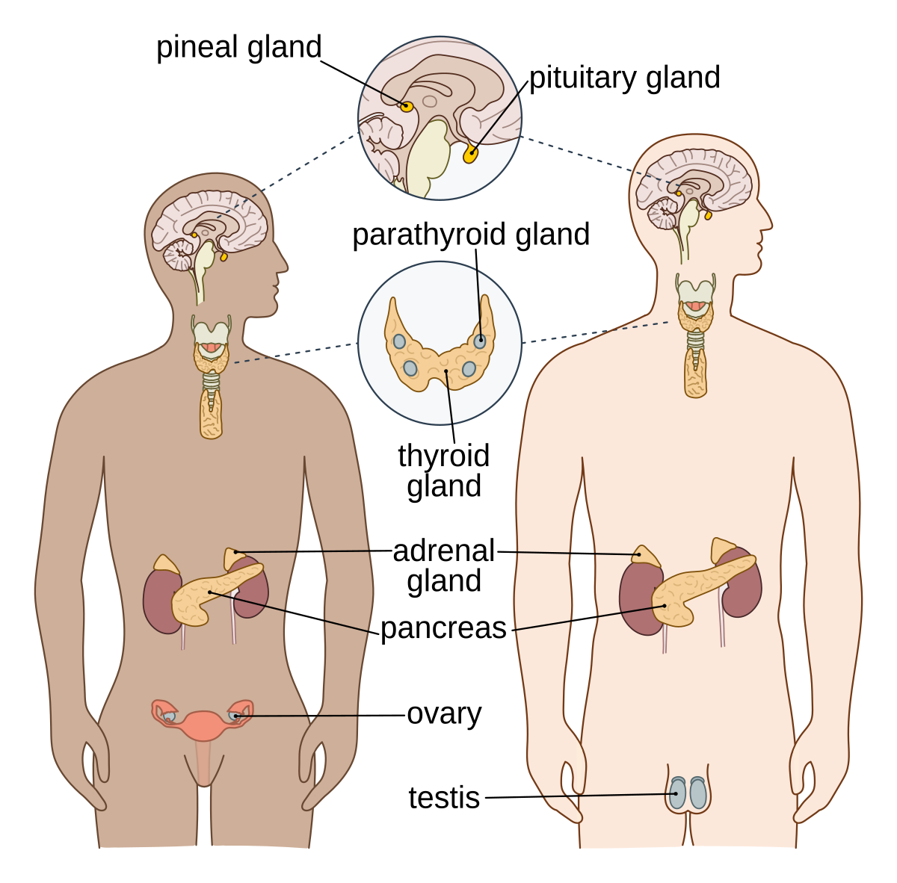
Introduction to the Endocrine System
The endocrine system is a complex network of glands that secrete hormones directly into the bloodstream. (Ductless gland). Hormones are chemical messenger.
These hormones regulate various bodily functions, including metabolism, growth, and mood.
Understanding the endocrine system is crucial for grasping how our body maintains homeostasis.
Notes:
Image source: https://upload.wikimedia.org

Slide 3
Major Endocrine Glands
The major glands include the pituitary, thyroid, adrenal, and pancreas.
Each gland produces specific hormones that influence different physiological processes.
The interaction among these glands is essential for hormonal balance in the body.
Notes:
Image source: https://upload.wikimedia.org

Slide 4
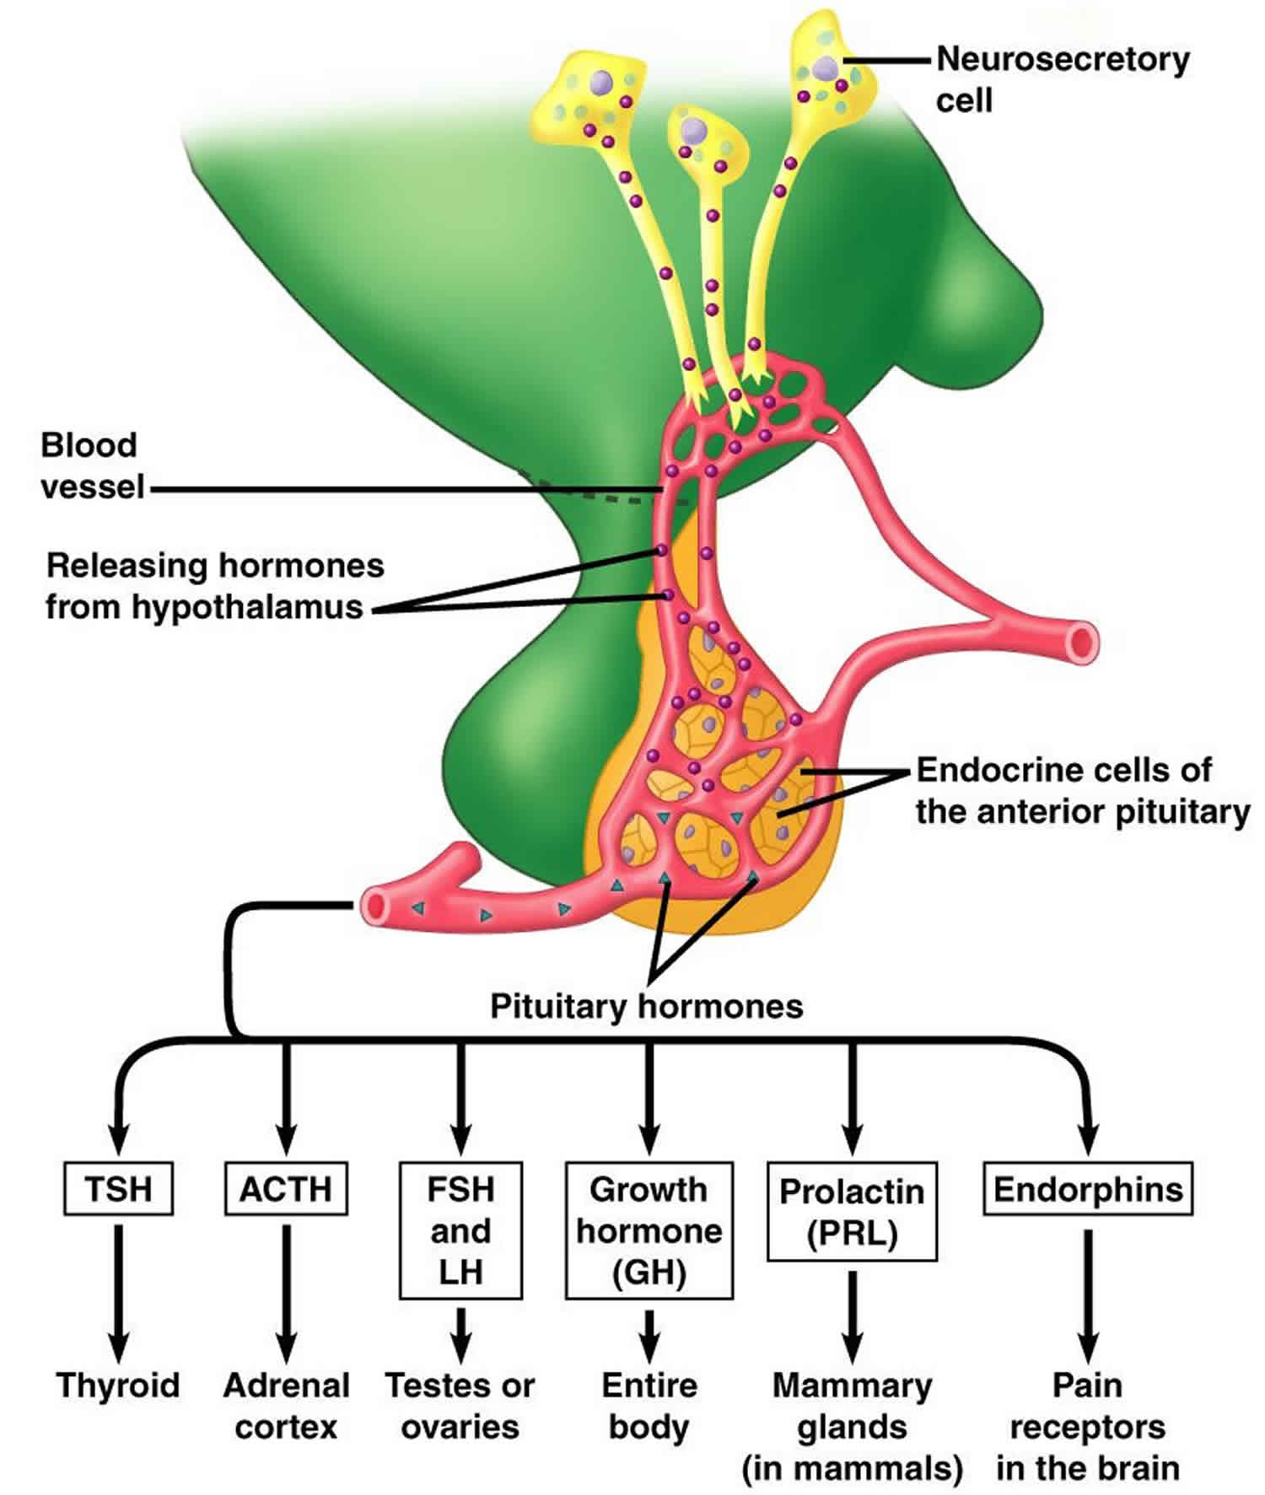
The Pituitary Gland
Often termed the "master gland," the pituitary controls other endocrine glands.
It secretes hormones like growth hormone and adrenocorticotropic hormone (ACTH).
The pituitary is divided into anterior and posterior sections, each with distinct functions.
Notes:
Image source: https://healthjade.com

Slide 5
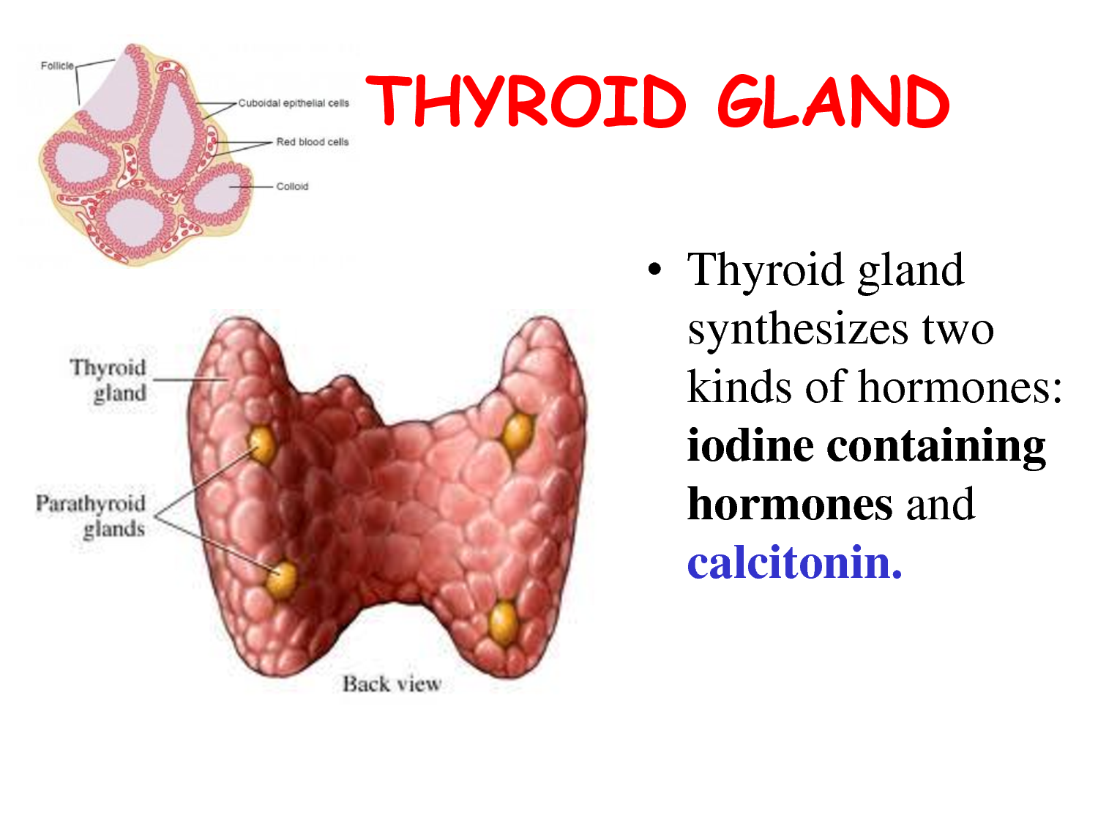
The Thyroid Gland
The thyroid gland regulates metabolism through hormones like thyroxine (T4) and triiodothyronine (T3).
It plays a critical role in growth, development, and temperature regulation.
Thyroid disorders such as hypothyroidism and hyperthyroidism can significantly impact health.
Notes:
Image source: https://sp-uploads.s3.amazonaws.com

Slide 6
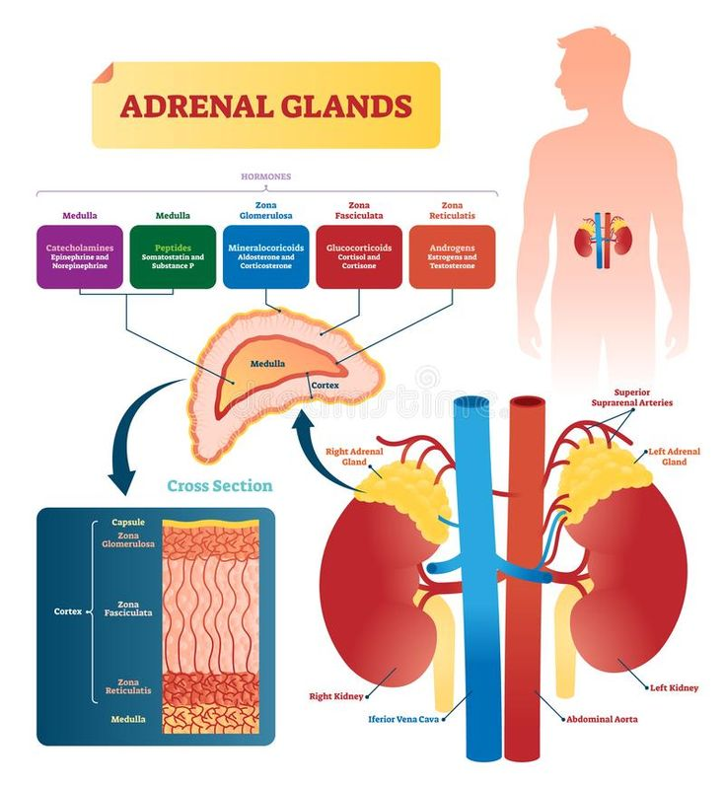
The Adrenal Glands
The adrenal glands produce hormones such as cortisol, adrenaline, and aldosterone.
These hormones help the body respond to stress and manage metabolism and blood pressure.
The adrenal cortex and medulla are two distinct regions that produce different hormones.
Notes:
Image source: https://i.pinimg.com

Slide 7
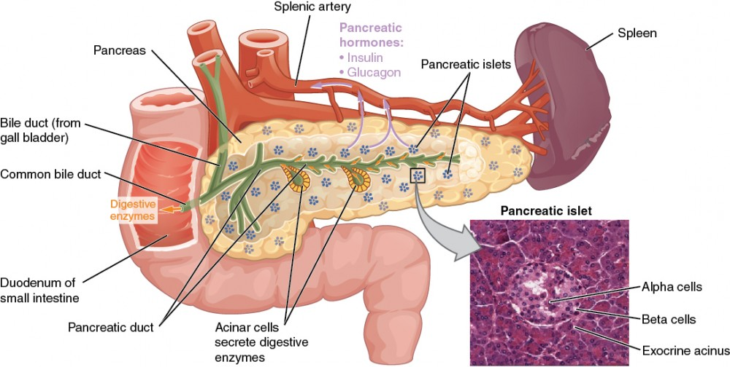
The Pancreas
The pancreas functions as both an endocrine and exocrine gland.
It secretes insulin and glucagon, which regulate blood sugar levels.
Dysfunction in insulin production can lead to diabetes mellitus, a significant health concern.
Notes:
Image source: https://s3-us-west-2.amazonaws.com

Slide 8
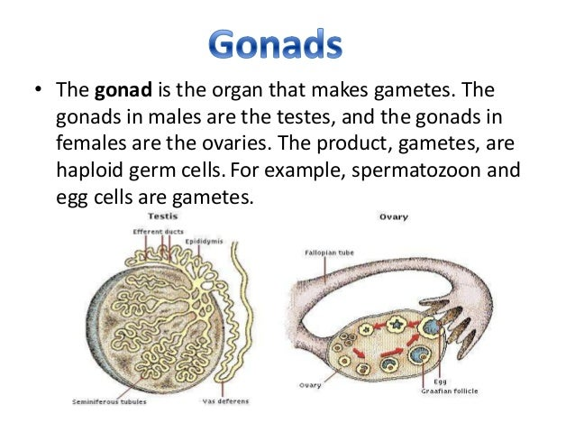
The Gonads
The gonads include the testes in males and ovaries in females.
They produce sex hormones such as testosterone, estrogen, and progesterone.
These hormones are vital for sexual development, reproduction, and secondary sexual characteristics.
Notes:
Image source: https://image.slidesharecdn.com

Slide 9
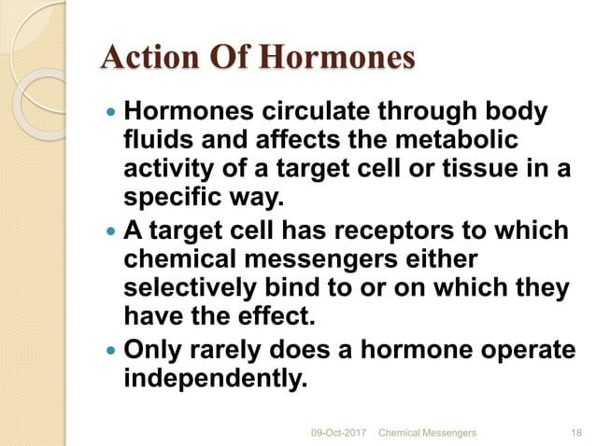
Hormones and Their Functions
Hormones act as chemical messengers that influence various physiological processes.
They can affect growth, metabolism, immune response, and mood regulation.
The effects of hormones can be immediate or long-term, depending on their function.
Notes:
Image source: https://image.slidesharecdn.com

Slide 10
Feedback Mechanisms
The endocrine system relies on feedback mechanisms to maintain homeostasis.
Negative feedback loops inhibit hormone production when levels are adequate.
Positive feedback loops amplify hormone production in response to specific stimuli.
Notes:
Image source: https://www.researchgate.net

Slide 11
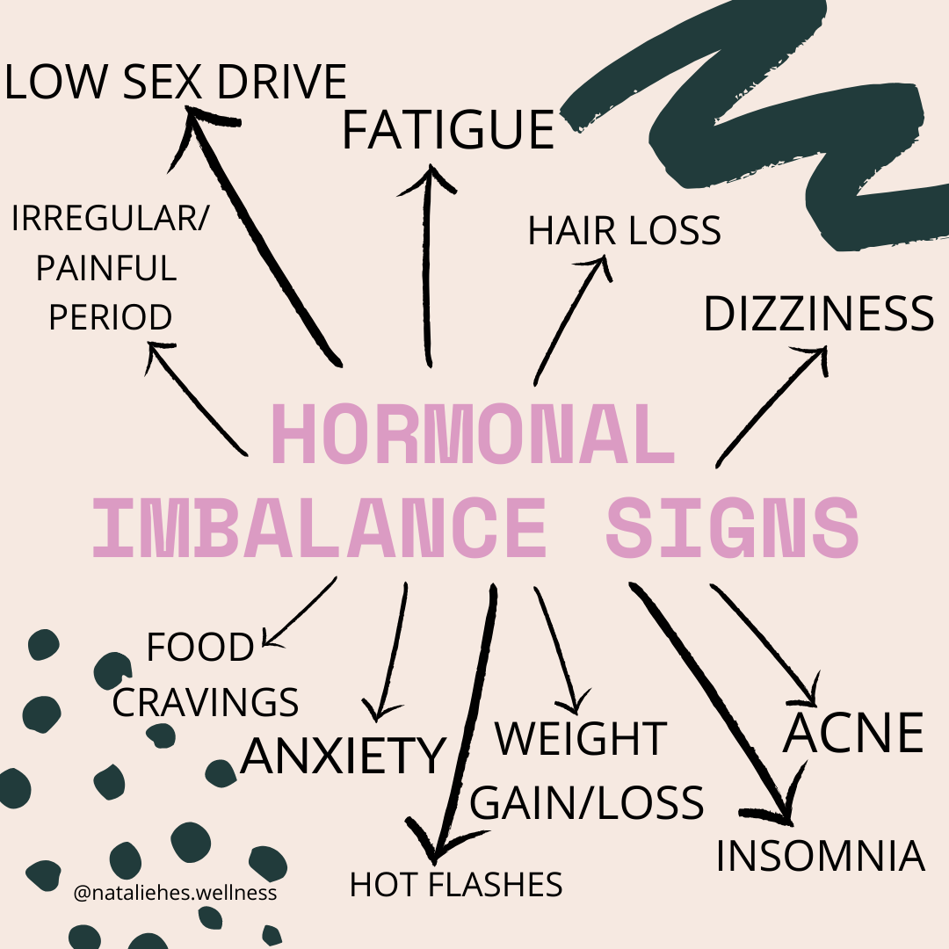
Hormonal Disorders
Hormonal imbalances can lead to various disorders affecting health and well-being.
Common disorders include diabetes, thyroid diseases, and adrenal insufficiency.
Early diagnosis and treatment are crucial for managing these conditions effectively.
Notes:
Image source: https://i.pinimg.com

Slide 12
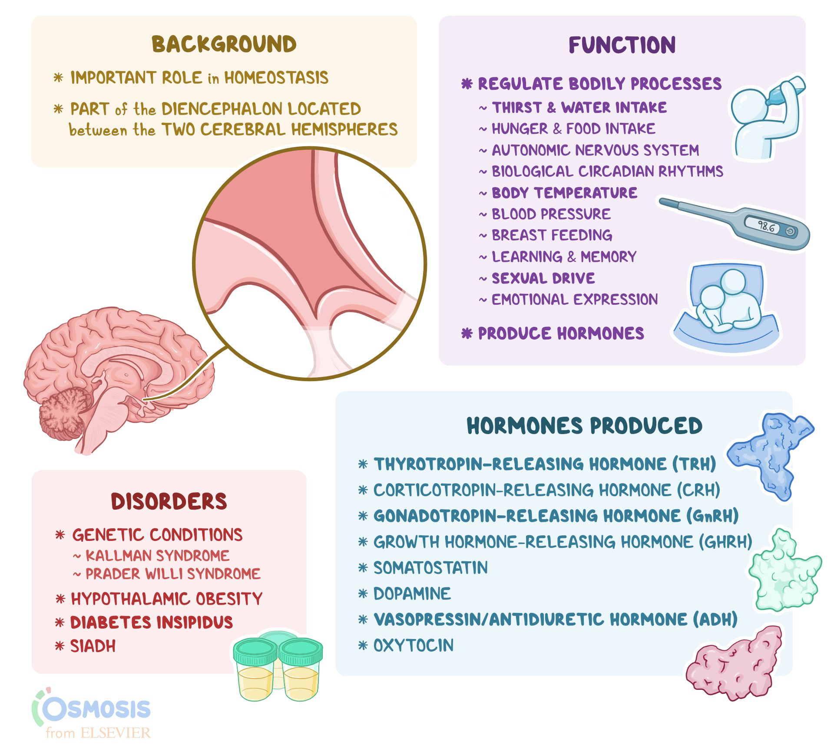
The Role of the Hypothalamus
The hypothalamus links the nervous system to the endocrine system.
It regulates the pituitary gland and produces hormones that control body temperature and hunger.
The hypothalamus plays a key role in maintaining homeostasis through its regulatory functions.
Notes:
Image source: https://d16qt3wv6xm098.cloudfront.net

Slide 13
Endocrine System and Aging
The endocrine system undergoes changes as we age, affecting hormone production.
For example, the production of sex hormones decreases during menopause and andropause.
Understanding these changes can help manage age-related health issues effectively.
Notes:
Image source: https://www.thelancet.com

Slide 14
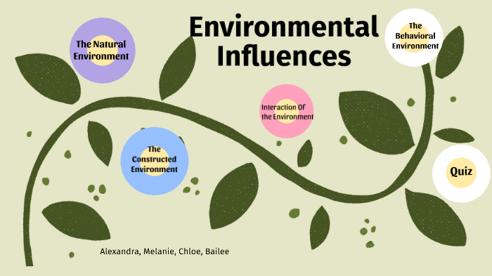
Environmental Influences on Hormones
Environmental factors such as stress, diet, and toxins can impact hormone levels.
Endocrine disruptors, found in certain chemicals, can interfere with hormonal balance.
Awareness of these influences is essential for maintaining endocrine health.
Notes:
Image source: https://0701.static.prezi.com

Slide 15
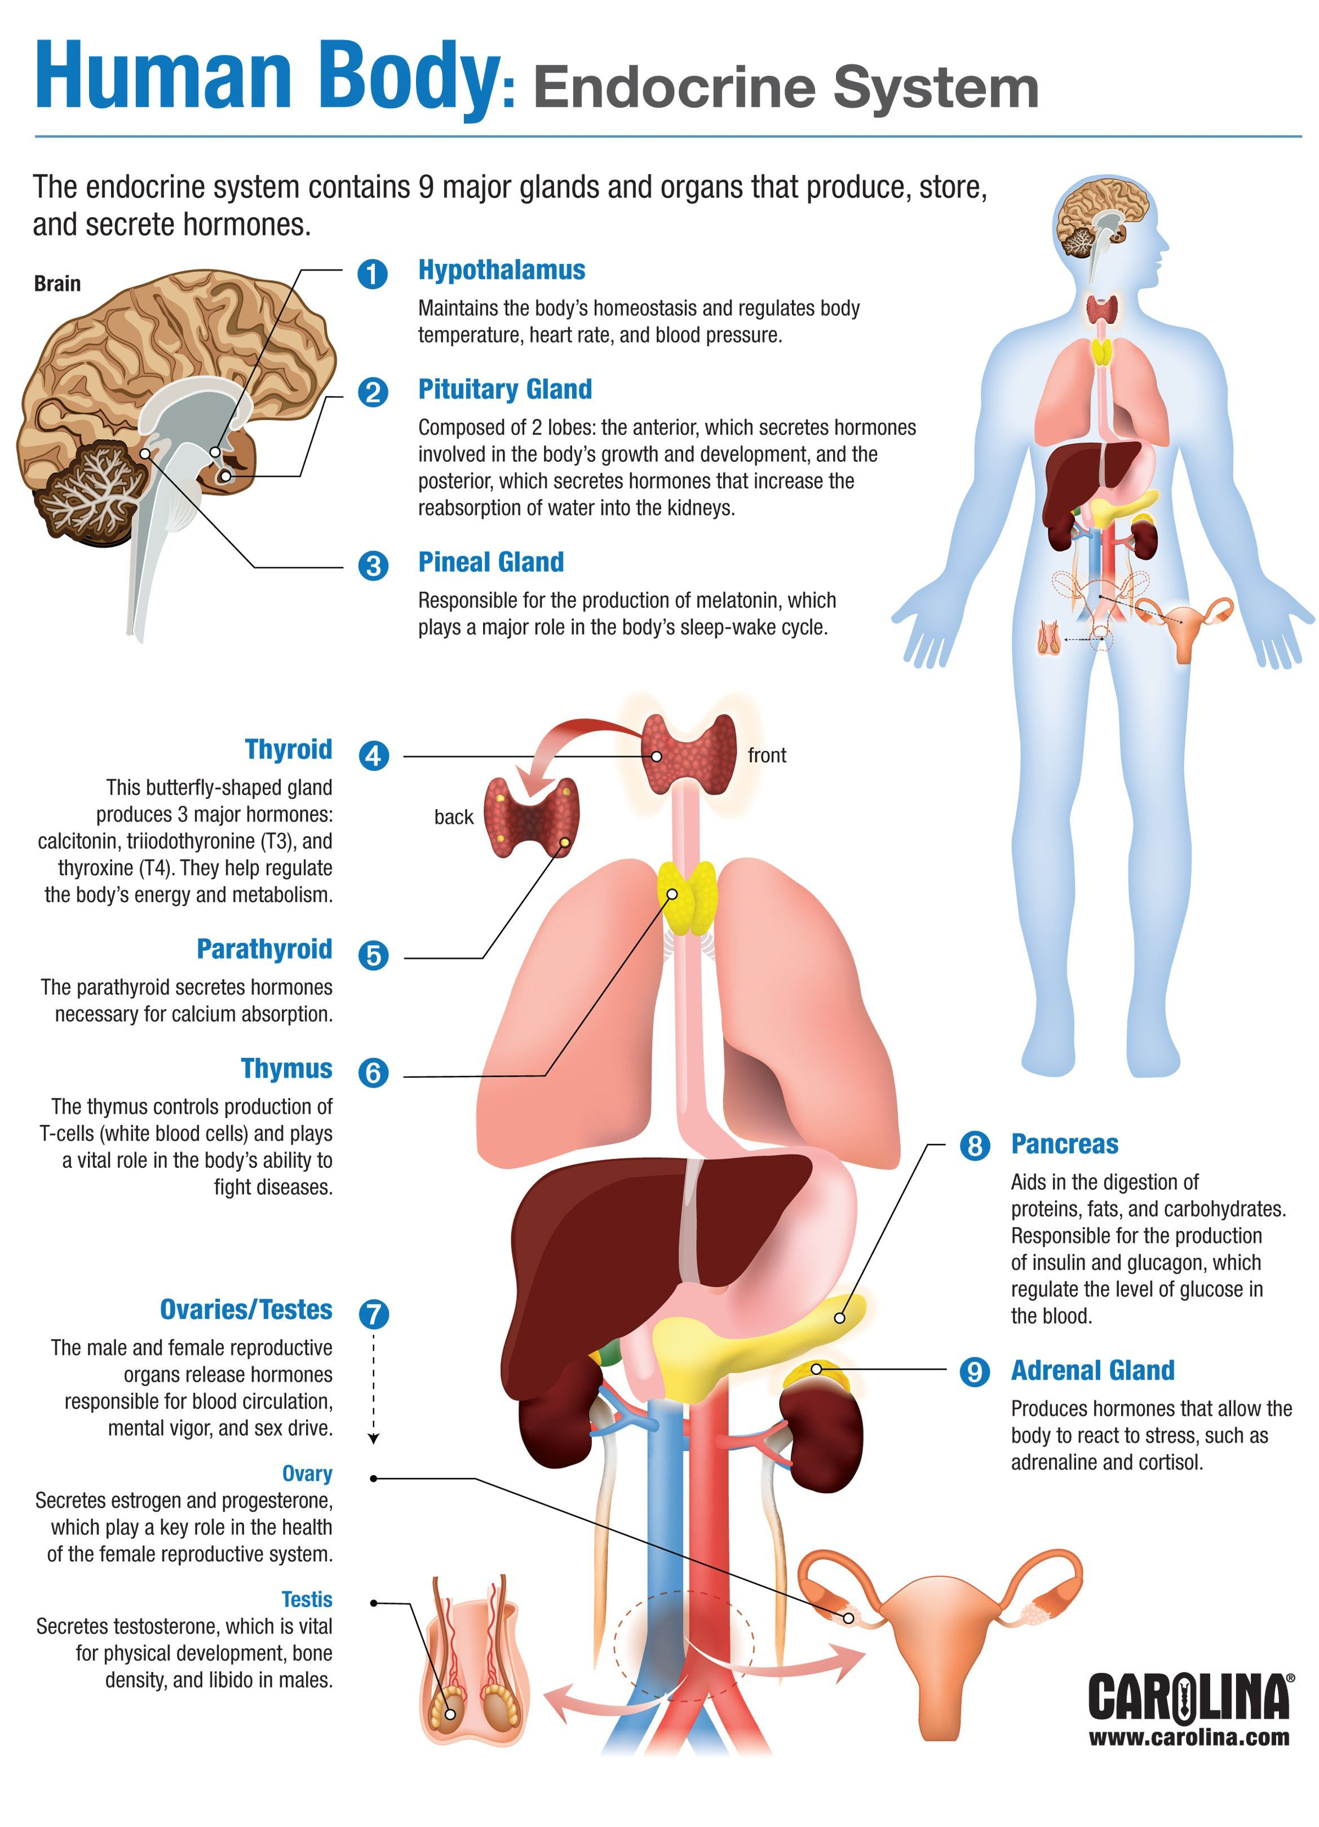
The Endocrine System and Mental Health
Hormones can significantly influence mood and emotional well-being.
Disorders such as depression and anxiety can be linked to hormonal imbalances.
Treatments may involve hormonal therapies alongside psychological interventions.
Notes:
Image source: https://i.pinimg.com

Slide 16
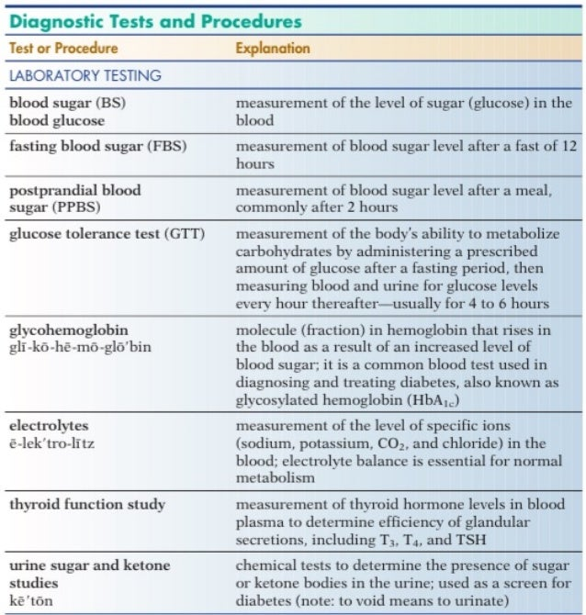
Diagnostic Tests for Endocrine Disorders
Blood tests are commonly used to measure hormone levels in the body.
Imaging studies may be required to visualize gland abnormalities or tumors.
Proper diagnosis is crucial for determining the appropriate treatment plan.
Notes:
Image source: https://image.slidesharecdn.com

Slide 17

Treatment Options for Endocrine Disorders
Treatment may include hormone replacement therapy, medications, or lifestyle changes.
Surgical interventions may be necessary in cases of tumors or gland removal.
Ongoing monitoring is essential to ensure effective management of endocrine disorders.
Notes:
Image source: https://www.shecares.com

Slide 18
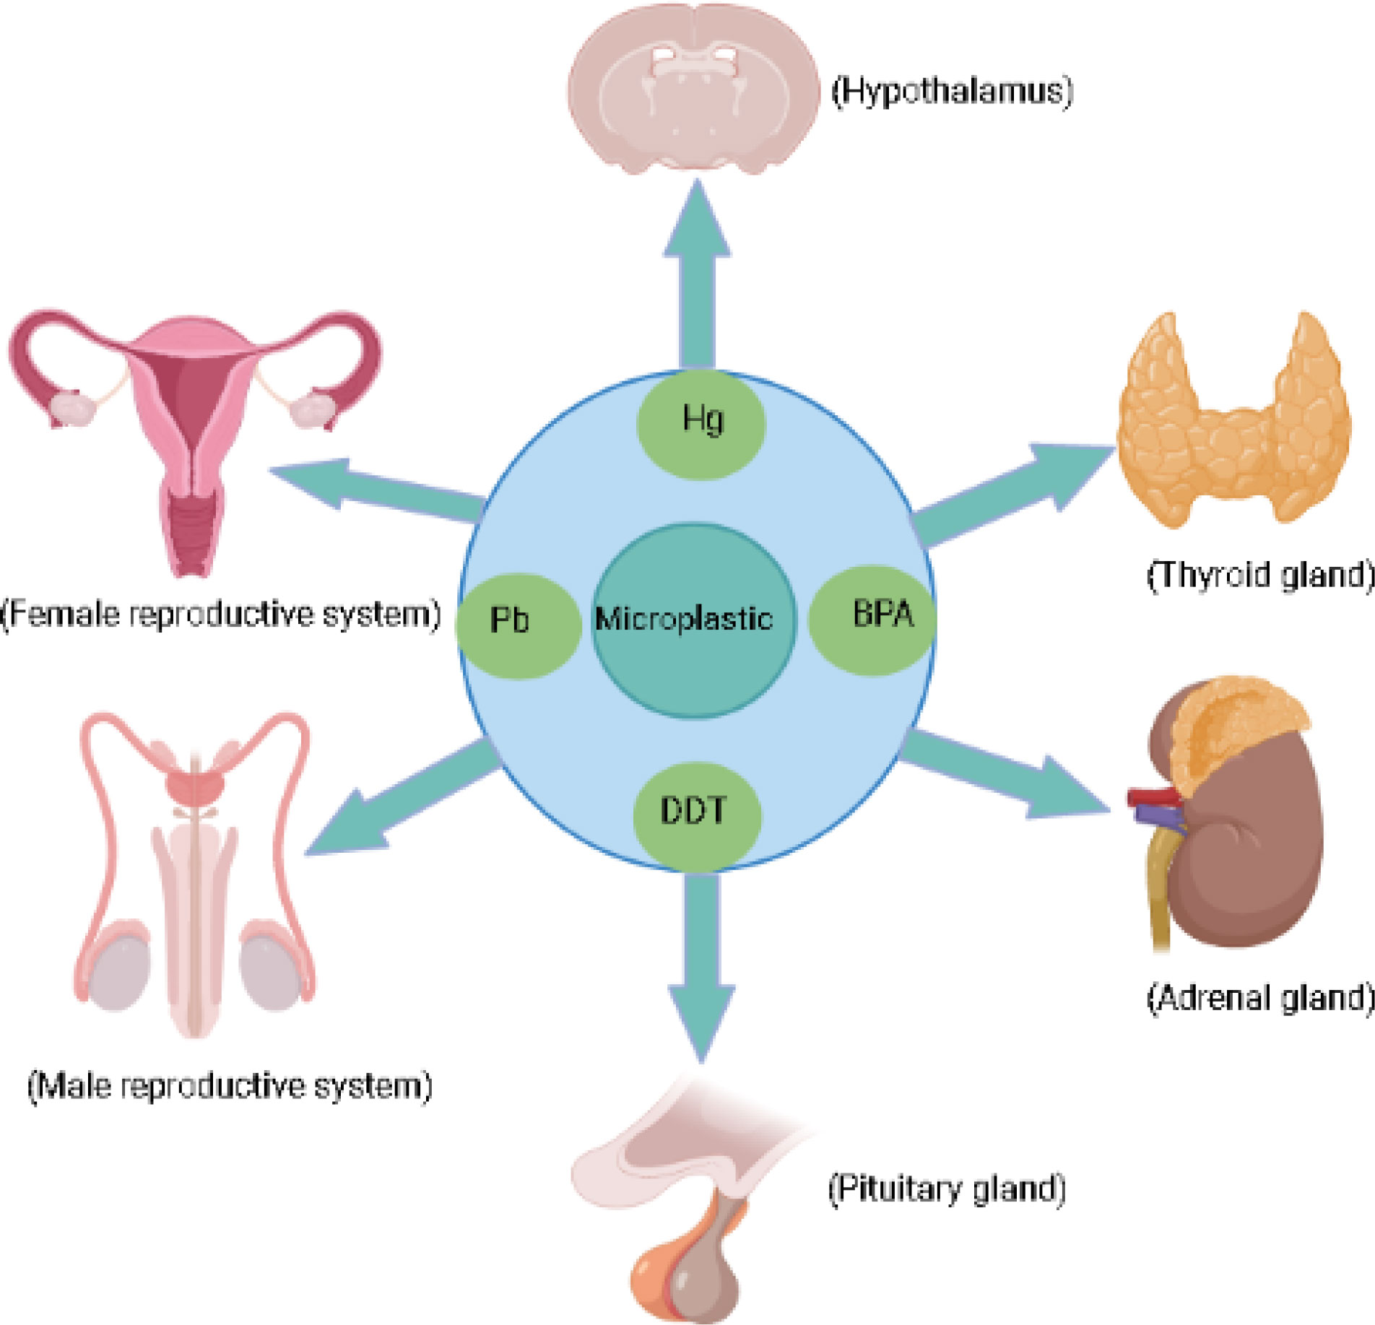
The Future of Endocrine Research
Research continues to explore the complexities of hormone interactions and functions.
Advances in biotechnology may lead to new treatments for endocrine disorders.
Understanding the endocrine system's role in overall health remains a critical area of study.
Notes:
Image source: https://www.frontiersin.org

Slide 19

Lifestyle Factors Affecting Endocrine Health
A balanced diet, regular physical activity, and stress management are crucial for hormonal health.
Avoiding endocrine disruptors in food and products can help maintain hormone balance.
Regular health check-ups can aid in early detection of potential endocrine issues.
Notes:
Image source: https://i.pinimg.com

Slide 20
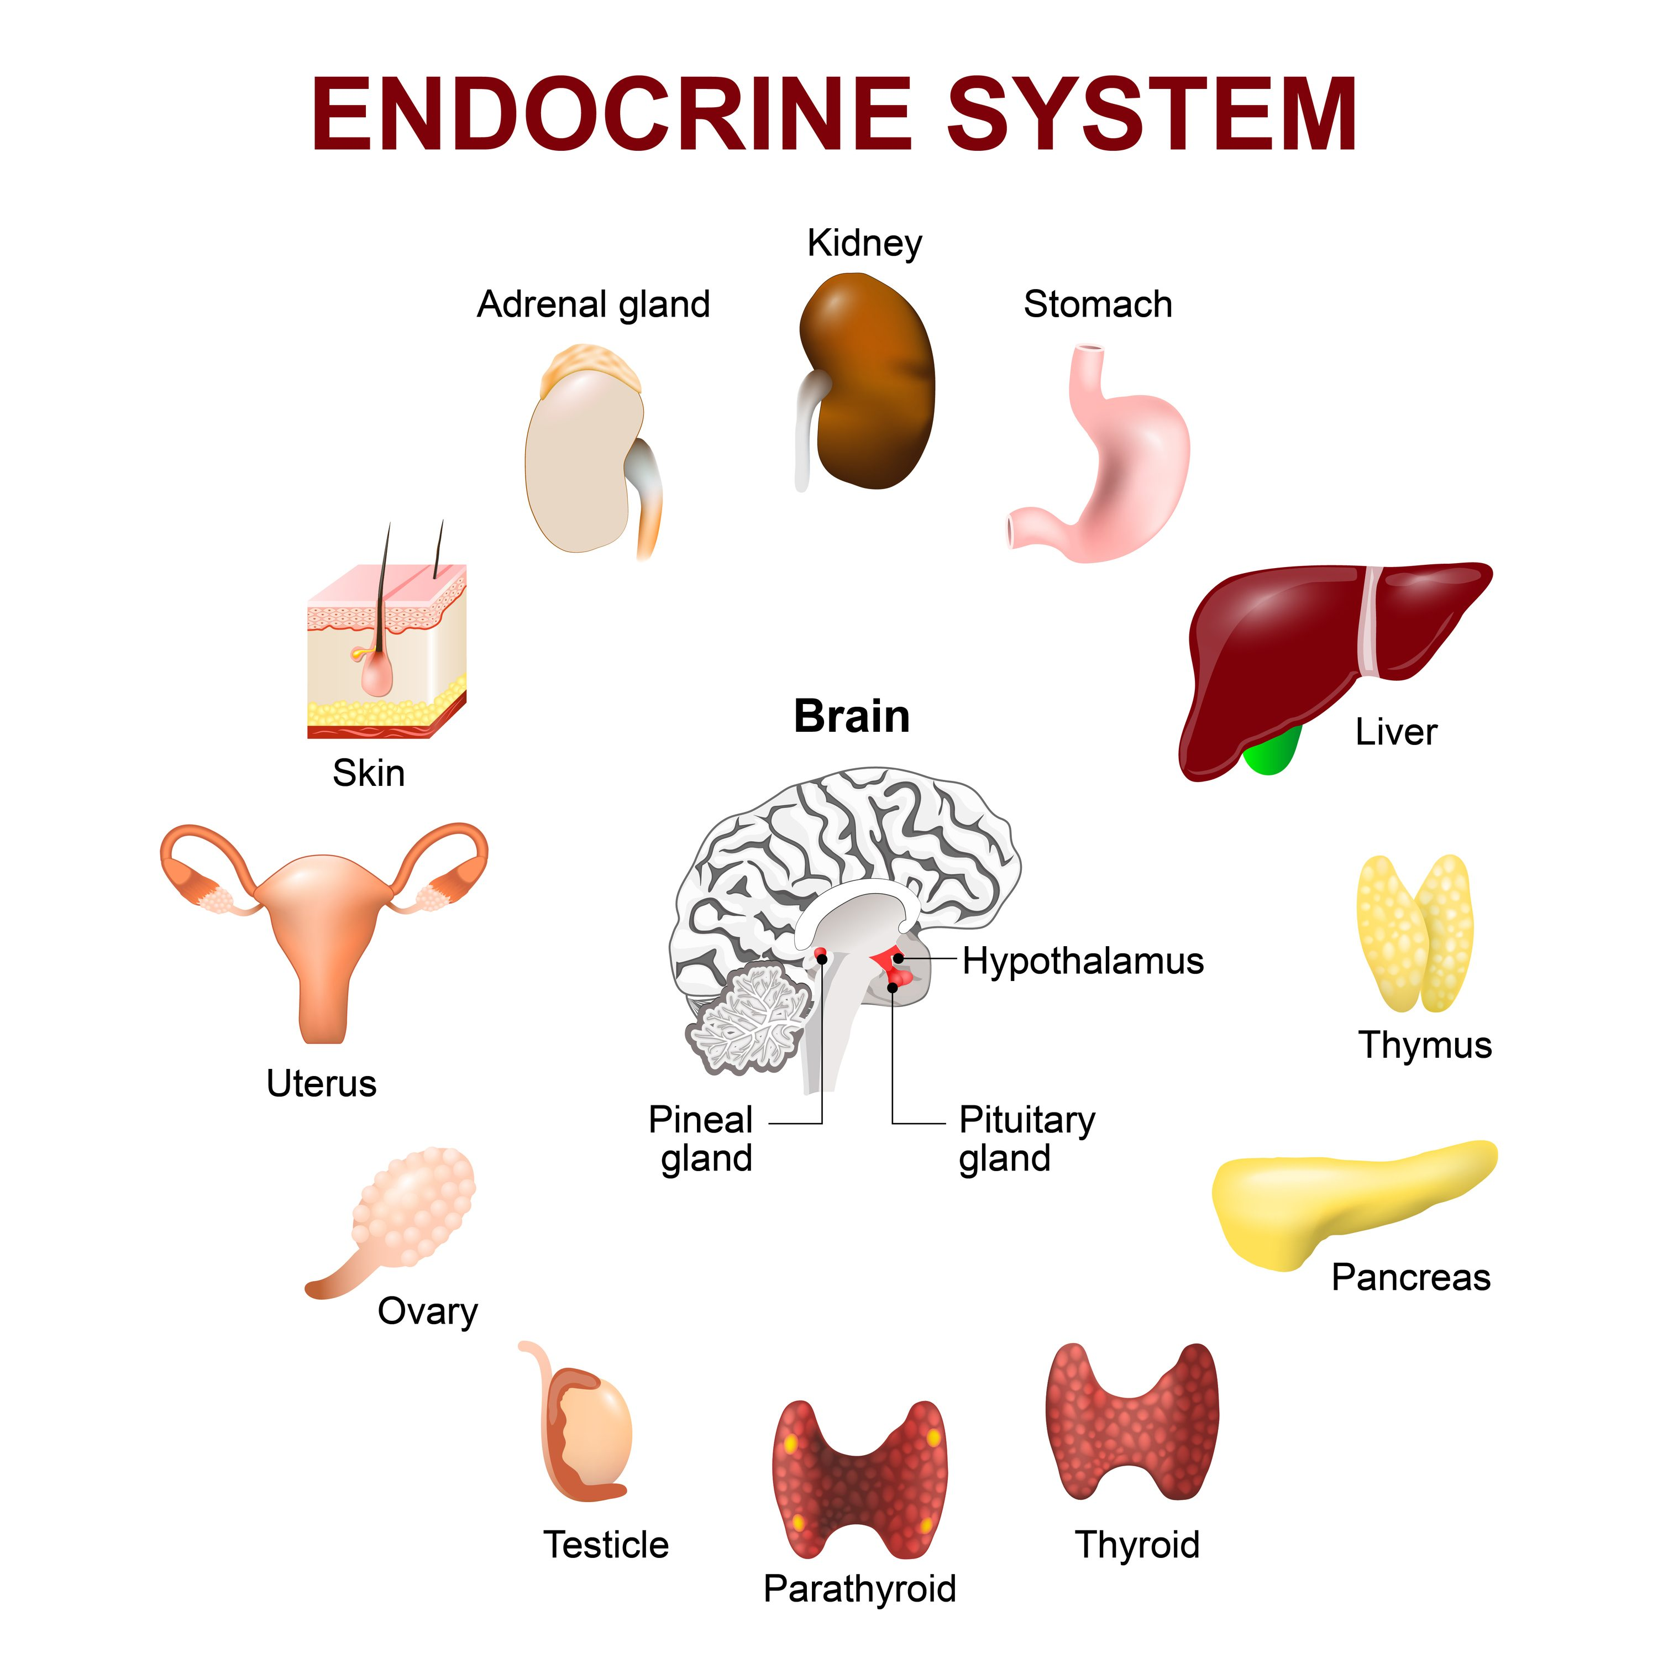
Conclusion
The endocrine system plays a vital role in regulating many bodily functions.
Understanding its complexities can lead to better health outcomes and disease prevention.
Ongoing education and research are essential for advancing our knowledge of endocrine health.
Notes:
Image source: https://theforceforhealth.com

Slide 21
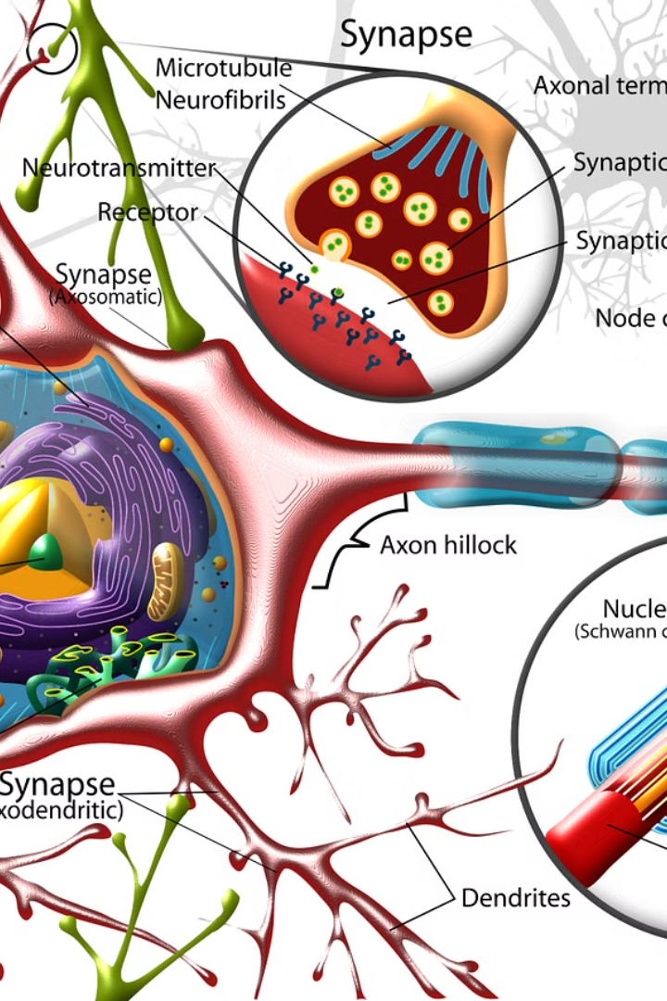

Features of the Structure of Nervous Systems
This presentation will explore the nervous system, a complex network that coordinates actions and sensory information. As the body’s communication hub, it manages everything from movement to breathing while processing sights, sounds, and touch. We’ll examine its structure, from neurons to the central and peripheral systems, to understand how it drives interaction and adaptation.

Slide 22
Introduction to the Nervous System
Definition
Main Parts
Objective
The nervous system is the body’s intricate communication network, seamlessly coordinating actions like movement and vital processes like heartbeat, while also processing sensory information such as light, sound, and touch.
The nervous system has two big parts: the Central Nervous System, or CNS, which is the brain and spinal cord, and the Peripheral Nervous System, or PNS, which is all the nerves outside the brain and spinal cord that spread through the body.
This presentation aims to help in the understanding of the structural features of the nervous system and their roles in function.

Slide 23
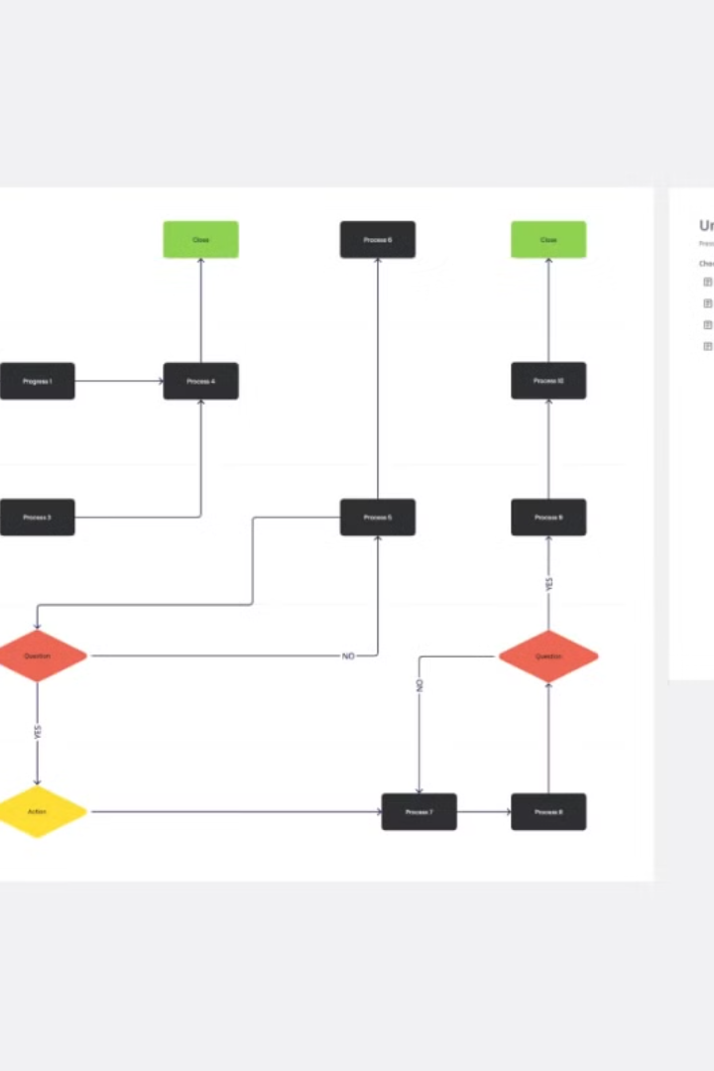
Overview of Nervous System Functions
1
Sensory Input
2
Integration
Detects stimuli such as light, sound, and touch.
Processes and interprets information received from sensory input.
3
Motor Output
Triggers responses such as muscle movement or gland secretion.

Slide 24
Types of Cells in the Nervous System
Neurons
Neuroglia
The core units responsible for signal transmission, these specialized cells form the foundation of the nervous system’s vast communication network, enabling rapid and precise coordination throughout the body."
These vital cells support and protect neurons, ensuring structural integrity and performing essential functions like nutrient delivery, insulation, and immune defense within the nervous system.

Slide 25
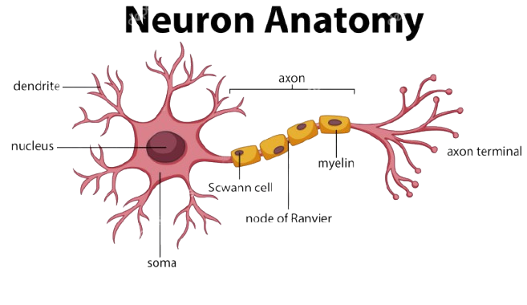
Neuron Structure
Cell Body (Soma)
Dendrites
Axon
Axon Terminals
Contains the nucleus and is the metabolic center of the neuron.
Receive signals from other neurons or sensory receptors.
Transmits signals away from the cell body to other neurons or effector cells.
Release neurotransmitters to communicate with other neurons or effector cells.

Slide 26
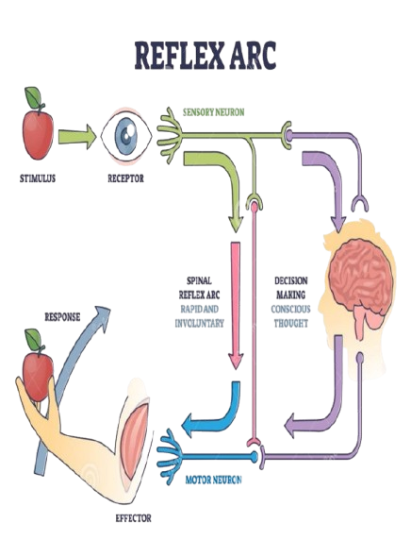

Types of Neurons
1
Sensory Neurons
Carry signals from sensory receptors to the CNS, providing information about the external environment.
2
Motor Neurons
Carry signals from the CNS to muscles and glands, initiating responses to stimuli.
3
Interneurons
Connect neurons within the CNS, facilitating complex processing and integration of information.

Slide 27
Myelin Sheath and Its Importance
Definition
Function
Comparison
A fatty layer that surrounds axons, this insulator enhances signal transmission by speeding up electrical impulses and protecting the nerve fibers.
Myelin speeds up signal transmission by allowing signals to jump between gaps in the myelin sheath, a process called saltatory conduction.
Myelinated axons transmit signals much faster and more efficiently than unmyelinated axons.

Slide 28
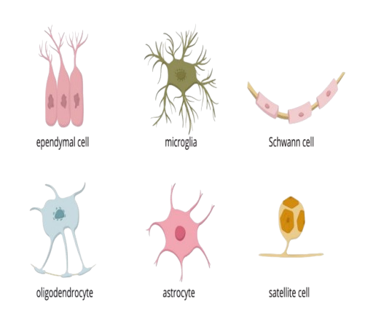

Glial Cells and Their Roles
Astrocytes
Nutrient support, blood-brain barrier
Oligodendrocytes
Myelin in CNS
Microglia
Immune defense
Schwann cells
Myelin in PNS

Slide 29
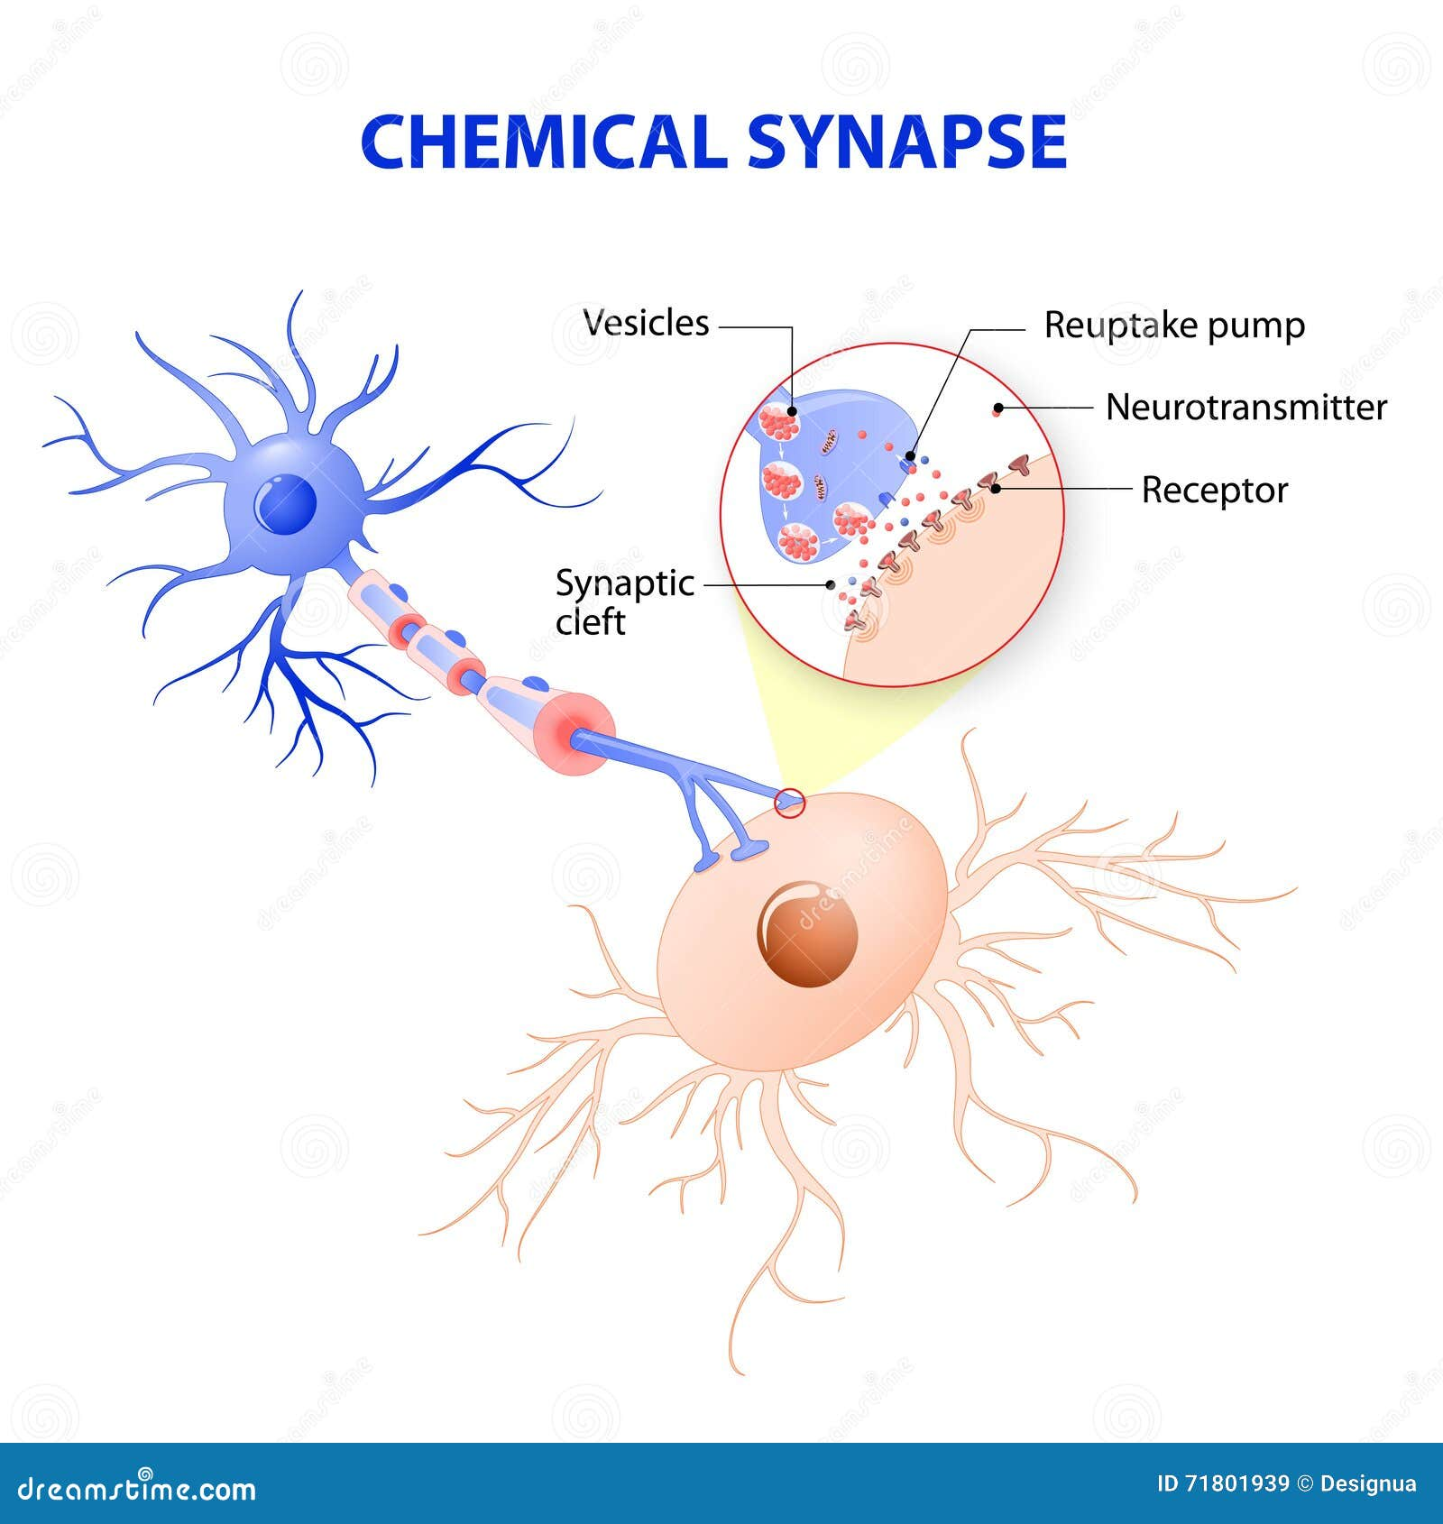
Synapses: Communication Points
Definition
A synapse is a junction between neurons or between a neuron and an effector cell, such as a muscle or gland.
Types
Synapses can be chemical, where neurotransmitters are released, or electrical, where signals pass through gap junctions.
Process
A signal arrives at the presynaptic neuron, triggering the release of neurotransmitters, which bind to receptors on the postsynaptic neuron, transmitting the signal.

Slide 30
Central Nervous System (CNS) Overview
1
Brain
The control center for processing and coordinating information received from the body.
2
Spinal Cord
Relays information between the brain and the rest of the body, and controls reflexes.

Slide 31
Brain Structure: The Control Center
Cerebrum
Cerebellum
Brainstem
The largest part of the brain, responsible for higher-level cognitive functions such as thinking, memory, language, and voluntary movement.
Located at the back of the brain, this region coordinates muscle movements, maintains balance, and regulates posture.
The connecting point between the brain and spinal cord, controlling vital functions like heart rate, breathing, and blood pressure.

Slide 32
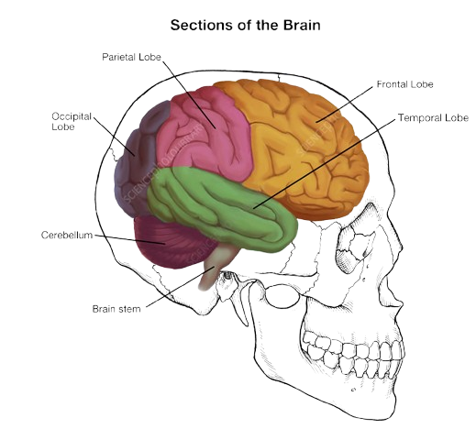
Cerebral Cortex: The Outer Layer of the Cerebrum
1
Frontal Lobe
Responsible for reasoning, planning, decision-making, and personality.
2
Parietal Lobe
Processes sensory information such as touch, temperature, pain, and pressure.
3
Temporal Lobe
Handles auditory processing, memory, language, and emotion.
4
Occipital Lobe
Processes visual information, enabling us to see and interpret the world around us.

Slide 33
The Spinal Cord: A Vital Pathway
Structure
Functions
Located within the vertebral column, the spinal cord is protected by bones and surrounded by cerebrospinal fluid (CSF), which cushions and nourishes it. The gray matter contains cell bodies, while the white matter consists of axons that carry signals up and down the cord.
The spinal cord serves as a vital communication pathway between the brain and the body, relaying signals for movement, sensation, and reflexes. It also plays a crucial role in coordinating reflexes, which are rapid, involuntary responses to stimuli. For example, pulling your hand away from a hot surface is a spinal reflex.

Slide 34
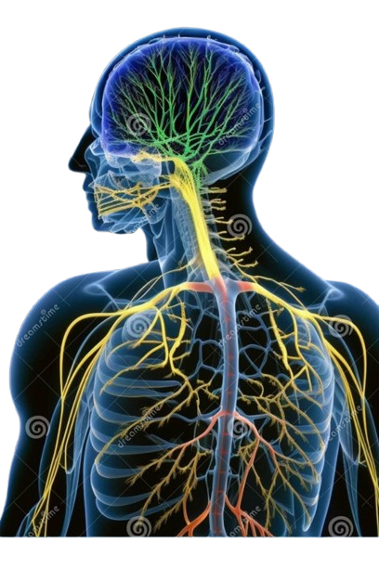
Peripheral Nervous System: Extending the Network
The peripheral nervous system (PNS) encompasses all nervous tissue outside the central nervous system (CNS). It is responsible for transmitting signals between the CNS and the rest of the body.
The PNS consists of nerves, which are bundles of axons, and ganglia, which are clusters of neuron cell bodies.
The PNS is further divided into two main branches: the somatic nervous system and the autonomic nervous system.

Slide 35
Somatic Nervous System: Voluntary Control
Voluntary Movement
Sensory Input
Reflexes
The somatic nervous system controls voluntary movements of skeletal muscles. It receives signals from the brain, which are transmitted through motor neurons to the muscles.
The somatic nervous system also receives sensory input from the skin, muscles, and other receptors, sending these signals to the brain for processing. For example, when you touch a hot surface, sensory neurons transmit pain signals to the spinal cord, which then relays them to the brain.
The somatic nervous system plays a crucial role in coordinating reflexes. These are rapid, involuntary responses to stimuli. For example, the knee-jerk reflex involves a simple pathway: a tap on the knee tendon activates a sensory neuron, which sends a signal to the spinal cord, triggering a motor neuron to contract the quadriceps muscle, causing the leg to kick.

Slide 36
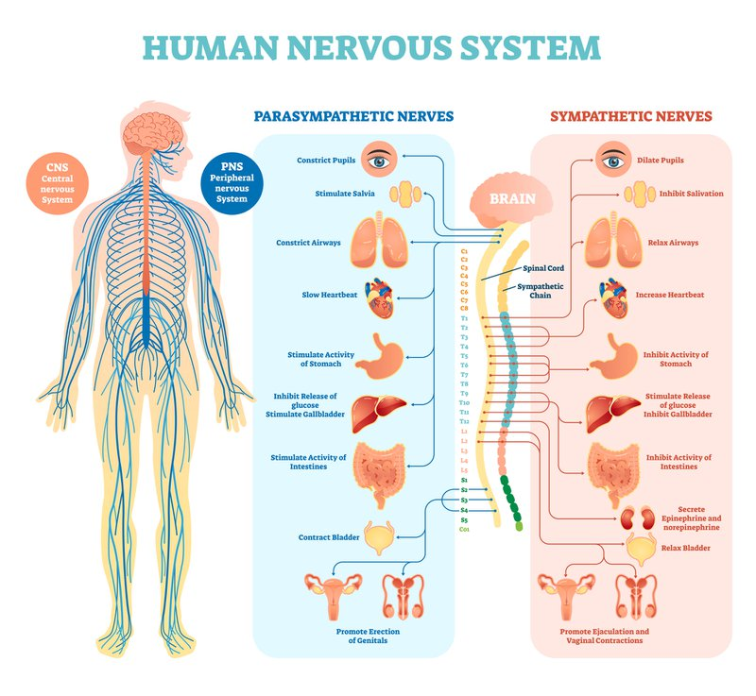
Autonomic Nervous System: Involuntary Control
Sympathetic: Speeds up body in stress.
Parasympathetic: Slows down body for rest.
The autonomic nervous system controls involuntary functions such as heart rate, breathing, digestion, and gland secretions. It operates independently of conscious control, ensuring the smooth functioning of our vital systems.

Slide 37
Nerve Structure: Bundles of Axons
Definition
Layers
A nerve is a bundle of axons, which are long, slender projections of neurons that transmit electrical signals. Nerves are found in the PNS and serve as the communication pathways between the CNS and the rest of the body.
Nerves are protected by three layers of connective tissue: endoneurium, which surrounds individual axons; perineurium, which encases bundles of axons called fascicles; and epineurium, which forms the outermost layer of the nerve.

Slide 38
Reflex Arcs: Rapid Response Pathways
Receptor
A specialized sensory cell that detects a stimulus, such as touch, light, or sound.
Sensory Neuron
Transmits the signal from the receptor to the spinal cord.
Spinal Cord
Processes the signal and generates a response.
Motor Neuron
Carries the signal from the spinal cord to the effector.
Effector
A muscle or gland that carries out the response, such as contracting a muscle or releasing a hormone.

Slide 39
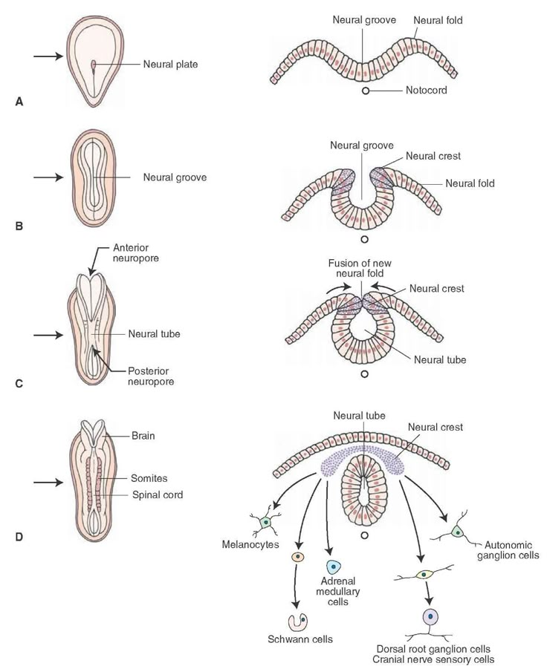
Nervous System Development: From Embryo to Adult
1
Neural Plate
A thickened region of the ectoderm, the outermost layer of the embryo, forms the neural plate.
2
Neural Groove
The neural plate folds inwards to form a groove, the neural groove.
3
Neural Tube
The neural groove closes up to form a tube, the neural tube, which will eventually develop into the brain and spinal cord.
4
Brain and Spinal Cord
The neural tube differentiates into the brain and spinal cord, with specialized regions developing from the anterior end of the tube. The brain develops into the cerebrum, cerebellum, and brainstem, while the spinal cord forms the central nervous system’s pathway for communication with the body.

Slide 40

Conclusion
Through this topic, we have explored the nervous system's structure, where neurons and glial cells form its foundation. The central and peripheral systems work together, with myelin, synapses, and plasticity enabling fast communication and adaptability. Understanding these elements helps us see how we sense, think, and move, opening doors to neuroscience and human biology.

Slide 41
References
Endocrine Society. (2021). Hormone Health Network. Retrieved from https://www.hormone.org
National Institute of Diabetes and Digestive and Kidney Diseases. (2020). Diabetes Overview. Retrieved from https://www.niddk.nih.gov
Mayo Clinic. (2022). Endocrine System Disorders. Retrieved from https://www.mayoclinic.org

Slide 42
THANK YOU

